Slide 1
REST API
With NODE.JS
tayakorn_s, dd/mm/yyyy

Slide 2

Agenda
Preparation
Node.js Basic
REST API
Best Practice REST API

Slide 3
Preparation

Slide 4
Node.js

Slide 5
Node.js
Node.js is a JavaScript runtime built on Chrome's V8 JavaScript engine.

Slide 6
Setup Node.js
Setup Node.js with `npm init`
Setup Babel `npm install --save-dev @babel/core @babel/cli @babel/preset-env @babel/node`
Setup build and run command Add build command to generate ES5 Add start command to run simple app

Slide 7
Callback / Promise / Async Await

Slide 8
"I will call back later!"

Slide 9
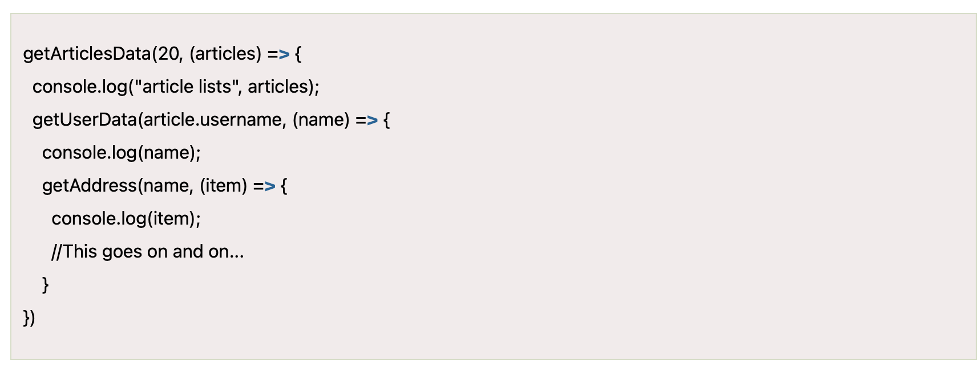
Callback
Accessible by another function.
It’s invoked after the first function if that first function complete.
Gives you the ability to be able to continue working and not just sit still and wait until the blocking operations come back.
It’s has new issue called `Callback Hell`.

Slide 10
"I Promise a Result!"

Slide 11
Promise
New way to implement asynchronous function.
Solved `Callback Hell` issue.
There are 3 states
Pending state
Resolved state
Rejected state

Slide 12
"async and await make promises easier to write"

Slide 13
Async Await
It’s same as Promise
Make code much simpler to read

Slide 14
Events and Event Emitter

Slide 15
Event Emitter
Publish data through event name
Subscribe data through event handler and event name

Slide 16
REST API

Slide 17
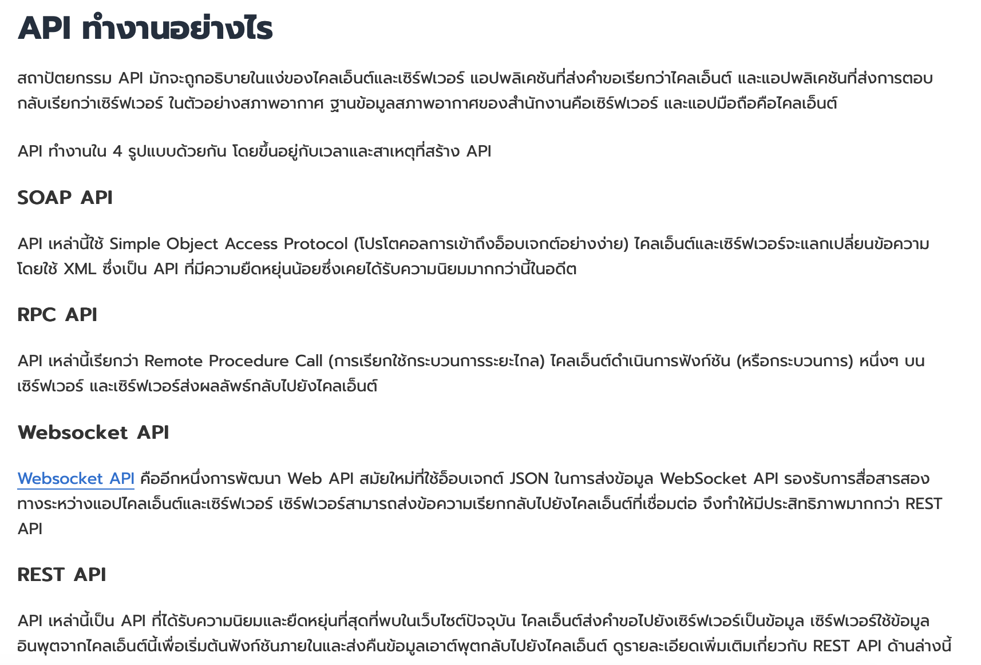
API
Application Programming Interface

Slide 18
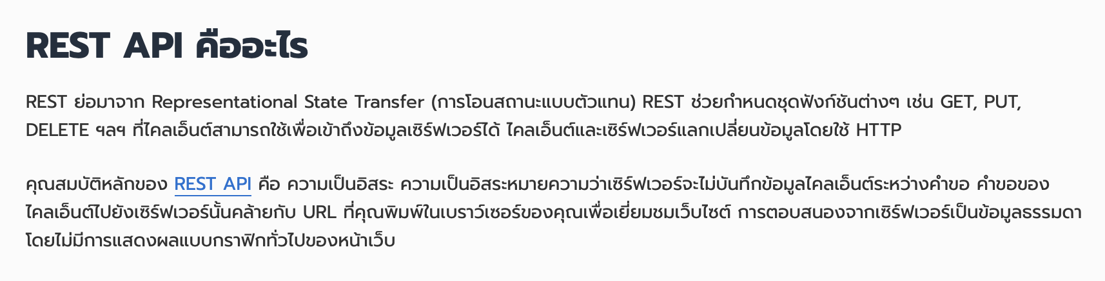
REST API

Slide 19
REST API
Method
GET
POST
PATCH
PUT
DELETE

Slide 20
REST API
Method GET
/todo
/todo/1
/todo/findByStatus/?status=todo

Slide 21
REST API
Method POST
/todo
/todo/{id}/uploadImage

Slide 22
REST API
Method PATCH
/todo/{id}

Slide 23
REST API
Method PUT
/todo/{id}

Slide 24
REST API
Method DELETE
/todo/{id}

Slide 25
Expressjs

Slide 26
Setup Expressjs

Slide 27
Workshop

Slide 28
REST API
Method GET
/todo
/todo/1
/todo/findByStatus/?status=todo

Slide 29
REST API
Method POST
/todo
/todo/{id}/uploadImage

Slide 30
REST API
Method PATCH
/todo/{id}

Slide 31
REST API
Method PUT
/todo/{id}

Slide 32
REST API
Method DELETE
/todo/{id}

